Slide 1
CRC and Analysis Class Diagrams
Group 3

Slide 2
CRC (Class Responsibility Collaboration)
Main UI Instantiates our Frame Handler.
FrameHandler generates threads needed.
GameHandler runs the game.
InputHandler listens for changes in commands i.e. accelerometer/rotation vector.
View Handler pauses and resumes the game. Can also close other views.
Snake stores body positions recorded through GameHandler.

Slide 3
CRC cont.
UI Mainframe
Create Menu Create/Display View Create Framework Handler | Framework Handler
Framework Handler
Create a New Game Exit Apps Create Input Thread | Game Handler Input Handler View Handler UI Mainframe
Game Handler
Start Game End Game Create Snake Check Snake Move Snake Keep Score Terrain Tracking | Snake Framework Handler

Slide 4
CRC cont.
View Handler
Resume Game Pause Game Destroy View | Framework Handler
Input Handler
Listen/Store Device Orientation
Snake
Store Snake Size/Positions

Slide 5
Analysis Class Diagram

Slide 6
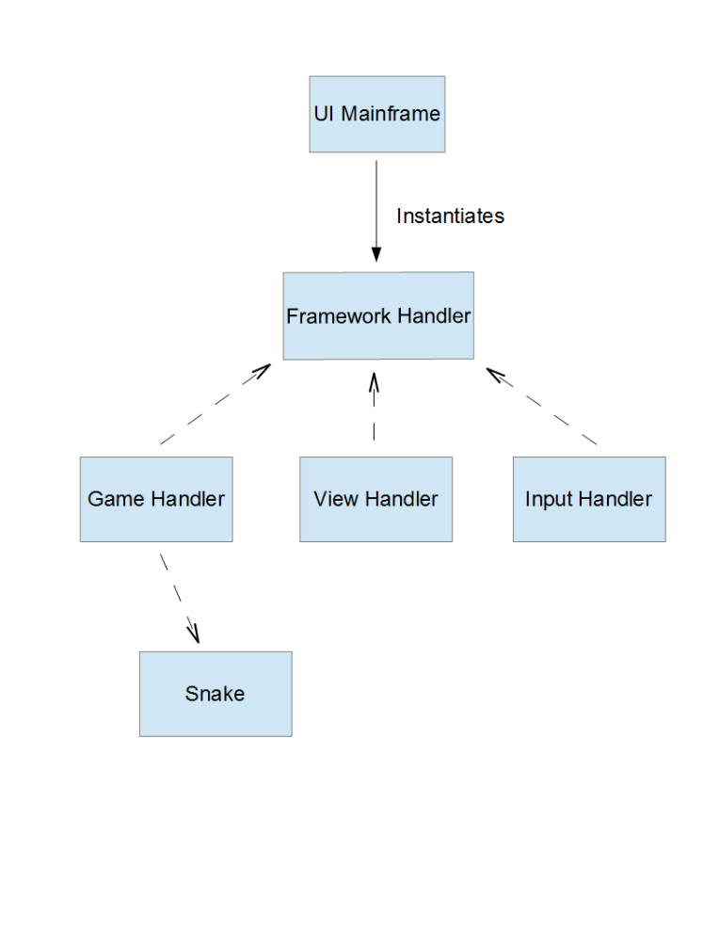
Analysis Class Diagram
UI MainFrame is associated with Framework handler.
FrameHandler is the “go-between” for the different handlers
Game Handler stores and recalls Snake positions.

